Slide 1


Intern Project
Declarative Multi-Tier Application Patterns in ICDS

Slide 2
Objective – Extreme Blue Program
Automation of provisioning through IBM patterns has been one of the key value add and differentiator for ICDS offering.
The key objective of Extreme Blue program is to explore the complex automation and enable cognitive capabilities for ICDS Standard patterns.
Objective : Multi-Tier Application Pattern
Development of Multi-Tier Application patterns for enterprise applications in ICDS
Development of a generic framework for deployment of multi tier application patterns
2
Notes:
2
2
2

Slide 3
Sample 3-tier Application
Presentation Tier (Web)
Business Tier (App)
Data Tier
(Database)

Slide 4
PoC - Multi-Tier Patterns in ICDS (vRA based)
Provisioning of Multi-Tier Patterns
Provisioning of Multi-Tier Patterns in ICDS
Use-Case: Deployment of patterns with more than one Operating System.
Applicability: Base Infrastructure for applications, Cluster Patterns
Use-Case: Deployment of patterns with more than one Operating System and performing all ICDS post provisioning capabilities including Chef-Automation and backend registrations integrations etc.
Applicability: App Ready Infrastructure for applications, Development Stacks such as WISA, LAMP etc.
RHEL 7
RHEL 7
Windows 2012
Agents, MW
Agents, MW
Agents, MW
RHEL
RHEL
Windows
Provisioning of Multi-Tier Application Patterns
Provisioning of Multi-Tier Application Patterns
Use-Case: Single click application deployment. Deployment of Multiple OS, ICDS automation, integrations and the application components.
Applicability: Deploy simple web applications.
Use-Case: Single click application deployment with interdependencies. Deployment of complex applications using vRA in ICDS..
Applicability: Deploy complex applications.
DB Tables
App Code
Web Code
DB Tables
App Code
Web Code
Database
App Server
Web Server
Database
App Server
Web Server
Agents
Agents
Agents
Agents
Agents
Agents
RHEL
RHEL
Windows
RHEL
RHEL
Windows
Notes:
4
4
4

Slide 5
Realizing the problem
Challenges of Multi-Tier Application Patterns
Application have dependencies between the server components.
Application deployment sequencing, needs back and forth deployment on servers in sequence.
EmployeeDB
Deploy app
Config http
Application Launches – Hello World
MySQL
Tomcat
http
Agents
Agents
Agents
RHEL
RHEL
Windows
The solution to overcome this challenge is to develop a vRO Workflow for each Application Pattern.
This would cost around 80-200 hours on development efforts of such Workflow.
Developed a framework solution where the multi-tier application patterns be provisioned without development of vRO workflow.
The framework comprises of defining the application dependencies in a table [declarative model].
Notes:
5
5
5

Slide 6
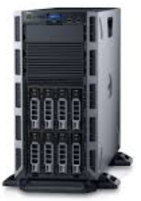
Decoding Application Dependencies
Database
App
Nodename
Nodename
IP
Web
IP
2. Apache Tomcat
1.MySql
4.Configuration of database
5.Application War file
3. Httpd

Slide 7
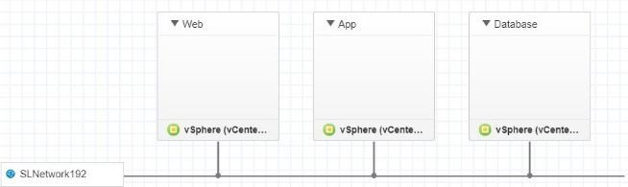

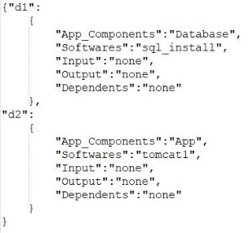
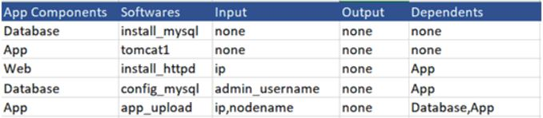

What Developer will do?
Declare Infrastructure
Blueprint
Declare App Dependencies
CSV file
ICDS Admin
Converted to JSON
Automation
Code
Configuration Management Tool

Slide 8
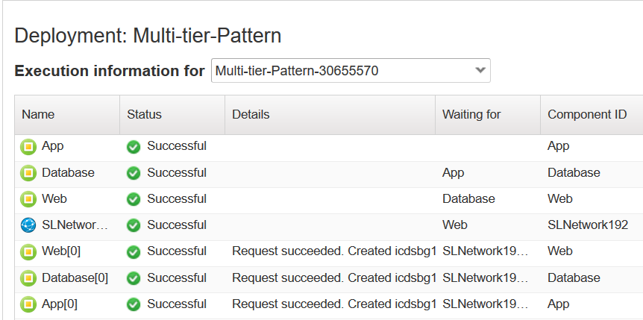
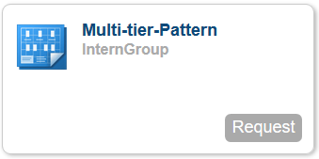
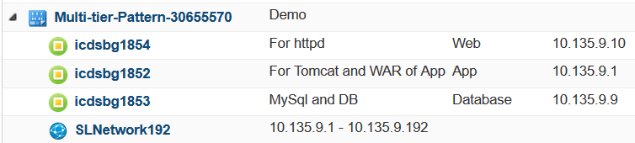
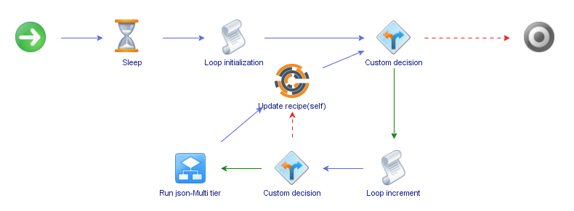
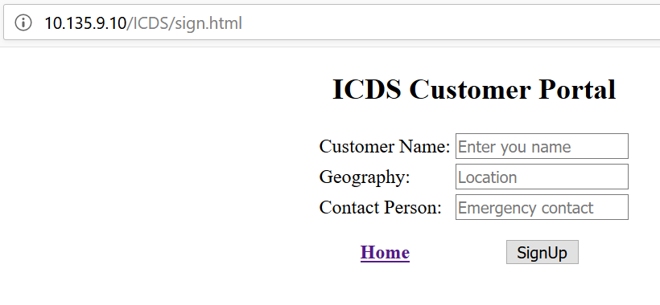
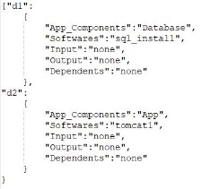
Framework to deploy Multi-Tier Application Patterns
Request
Deployment
Deployed
Engine
App run
App Description

Slide 9
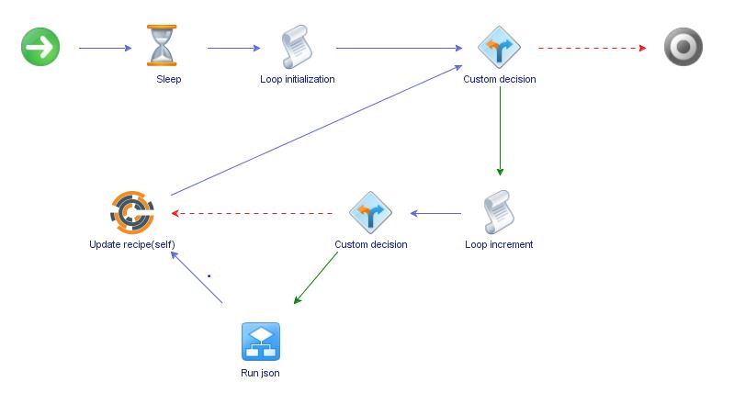
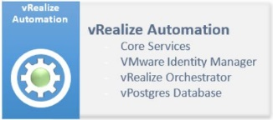
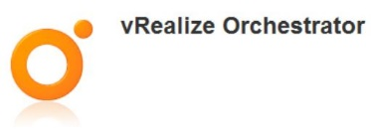
Understanding the Engine
Workflow
App declaration
Input JSON file

Slide 10
THANK YOU
☺

